Slide 1


Project Name
Indian Retail Sales Analysis
Notes:
title

Slide 2
Index
Title
Index
3-5. Back Story
6. Excel presentation
7. Data understanding
8. Data Cleaning
9. Data Transformation
10. Dash Board Creation
11. Excel Dash Board
12. Conclusion
Notes:
Indexing

Slide 3
Color Pallet
Baground, Upi percentage, Sales across cities, quantities of products
Baground
Sales across cities, Net banking percentage, Sales of products
Cash percentage ,All categories less performance bar
Credit card percentage, Sales during period of time
Picture baground
Product discount, icon pic, Headings
Profit of products, Region wise revenue
Notes:
Color pallet & Color theory

Slide 4
Back story: Indian Retail Sales Analysis
The Indian retail sector has experienced substantial growth in recent years, resulting in an ever-increasing volume of data. However, raw data alone holds little value without the ability to analyze and draw meaningful insights from it.
Background
In previous time Local Markets were only option for the public to buy the groceries or clothing or electronics items but as of now new Retails markets are came into existence with offers and reaching customer satisfaction by providing offers, delivering items with in low time so most of the people are trying to going retail markets like DMART, Reliance.
In Earlier people need to going to several shops to buy items but in present all items are getting available at one stop. In this situation also one of my nearest local shop takes more sales because
they are focused on relationships, consistency, adaptation and
Personalized service -knew every customer by name
Flexible inventory-added high-demand items fast
Local delivery during lockdowns
Loyalty rewards for repeat buyers
Low-cost, high-efficiency operations
While others prioritized volume, they struggled with poor customer service, ignored emerging online trends, and were burdened by high overhead costs.
Notes:
Back Story

Slide 5
The Turning Point
When COVID struck, many stores shut down permanently. In response, store owners began taking phone orders and delivering items directly to customers using their own vehicles. It wasn’t a high-tech solution-it was a high-touch, personal approach.
The Outcome While other stores vanished, that local shop didn’t just survive-it thrived. It became the neighbor hood's trusted choice and tripled its revenue by year three.
Conclusion:-
The development of the Indian retail industry reveals an important lesson: success is not just about size or technology it’s about comprehending and meeting the needs of the customer. In a time when numerous companies pursued quantity and fads, a local store distinguished itself by emphasizing trust, flexibility, and personal relationships. Its capacity to adjust swiftly, provide tailored assistance, and forge solid community connections not only enabled it to endure a crisis but also to thrive more than ever. This scenario highlights the significance of combining data-driven insights with a human-focused strategy to shape the future of retail in India.
Notes:
Conclusion of story

Slide 6
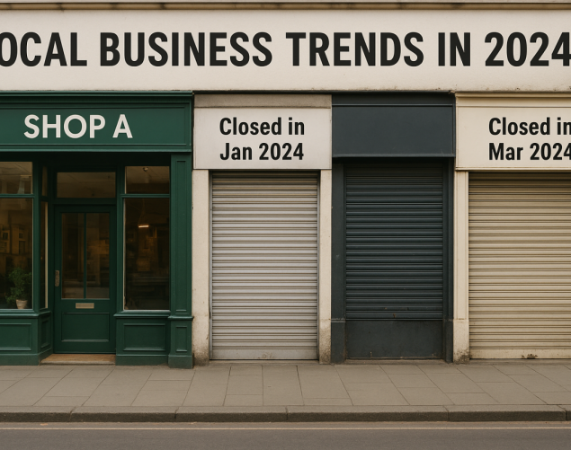
Proof for local shops survives
Here shop A getting more profit for their loyalty and trend rules but incase other’s opened and closed in short period of time because
. They don’t know how to maintain items
. They do not how to follow uptrends.
Notes:
proof

Slide 7
Excel presentation

Slide 8
Step 1: Data Understanding
Data Understanding: Overview of Dataset Columns
This step is essential because it helps us familiarize ourselves with the data and plan the next steps in the analysis. Let's break down each column in the dataset and understand their role:
Here Three Data types are there Categorical(String), Date/Time, Numerical (Decimal, Integer)
These are the columns used 1.Order ID (A unique identifier for each order), 2.Order Date, 3.Customer Name,
4.Region, 5.City, 6.Category, 7.Sub-Category 8.Product Name, 9.Sales Amount, 10.Quantity 11.Discount(%),
12.Profit, 13.Delivery Status, 14.Payment Method
Notes:
Data understanding

Slide 9
Step 2: Data Cleaning & Preprocessing:
Data cleaning is a crucial part of the data analysis process. In this step, we'll prepare the dataset by removing any inconsistencies, handling missing data, and ensuring that all values are in a usable format. Here’s a breakdown of the tasks we’ll focus on:
Removing Duplicates:
Go to Data → Remove Duplicates in Excel.
Select columns to check for duplicates (typically Order ID).
Click OK to remove duplicates.
Handling Missing Values:
For numerical columns, you could use the AVERAGE() or MEDIAN() function to fill missing values.
For categorical columns, use IF() to check for blanks, or fill in a placeholder (e.g., “Unknown”).
Standardizing Text Format:
Use =PROPER(Cell) to capitalize the first letter of each word in a text cell.
For instance: =PROPER(A2) would turn “furniture” into “Furniture”.
Notes:
Data cleaning

Slide 10
Step 3: Data Transformation:
In this step, we will manipulate the data to make it more useful for analysis. This includes creating new columns, calculating metrics, and ensuring the data is in a format that allows easy reporting. Here’s how we can transform the data:
Year-Month Column:
Order Date: 2025-05-11
Year-Month Column Formula: =TEXT(A2, "yyyy-mm") Result: 2025-05
Profit Margin:
Sales: ₹5000
Profit: ₹1500
Profit Margin Formula: = (1500 / 5000) * 100 Result: 30%
Sales Category:
Sales Amount: ₹12000
Sales Category Formula: =IF(A2 > 10000, "High", IF(A2 > 5000, "Medium", "Low")) Result: High
Notes:
Data transformation

Slide 11
Step 4: Dashboard Creation In this step, we'll create a comprehensive Excel Dashboard to track real-time business KPIs, display relevant metrics, and offer interactive components for deeper insights.
Ex:
What is the total revenue generated across all cities? Columns: Sales Amount, city Chart Hint: Bar Chart (Region-wise)
📊 Insights from City-wise Sales Chart
Top Performing Cities:
Bhubaneswar (₹5.17L) and Bangalore (₹5.07L) have the highest sales, showing strong retail demand.
Patna (₹5.07L) also performed surprisingly well, indicating a rise in Tier-2 city consumption.
Mid-Level Performers:
Chennai, Hyderabad, Kolkata, Jaipur, and Ahmedabad show stable and consistent sales between ₹3.7L to ₹4.7L.
Low Performing Cities:
Pune (₹2.36L) and Mumbai (₹2.45L) show unexpectedly lower sales, possibly due to local competition, high costs, or market saturation.
Nagpur and Indore also fall under the lower performance range.
Interesting Observation:
Chandigarh (₹3.36L) and Lucknow (₹3.65L) perform better than larger cities like Mumbai, highlighting shifting trends toward emerging cities.
Notes:
insights

Slide 12
Excel Dash Board
Notes:
Dash board

Slide 13
Conclusion
Takeaways from Indian Retail Sales Analysis
Sales Growth: Steady Year over year increase, especially in Food items & apparel segments.
Urban vs Rural: Urban retail outperformed rural; metro cities lead in revenue.
Consumer Trends: Shift towards online , cashless payments observed.
Seasonal Impact: Festive seasons drive spikes in monthly sales.
Insights: Focus on digital strategy, inventory optimization & customer retention.
"This analysis highlights the growing potential of Indian retail, urging businesses to embrace digital transformation and data-driven strategies."
Notes:
Conclusion

Slide 14
Thank you

